Slide 1

Medical Device Inventory Management System Project
Di Zheng, NUID: 002300601
Linlin Fan, NUID: 002067502
Rajath Kiran Hegde, NUID: 002756186
TA: Peifang Chiang

Slide 2
Table of contents
Project Context & Challenge
Our Solution: Innovative Device Sharing via Modularity
Modularity in Action: Da Vinci Robot System
Project Structure of PHS Network
Resource Bundle Reservation Workflow between Hospitals
Device Procurement Workflow in one Hospital
Acceptance Criteria
Goals of the Project

Slide 3
Project Context & Challenge
Foundation:
  Medical Device Management for a service provider network Partners HealthCare System (PHS).
Core Challenge:
  Advanced medical devices (like surgical robots) - extremely high acquisition and maintenance costs
  Individual institutions - low utilization rates & inefficiency
Key Impacts:
  Significant financial burden on healthcare providers,
  underutilization of critical resources,
  potential barrier to accessing latest technology.

Slide 4
Our Solution: Innovative Device Sharing via Modularity
Objective:
  Improve utilization of expensive device;
  reduce overall costs by facilitating sharing across the network;
Key Innovation:
  Leverage Modular Design principles in advanced medical devices to enable a flexible, on-demand sharing model
System Scope:
  Addresses core requirements for inventory visibility, cross-network sharing, dynamic scheduling, and warehouse management.

Slide 5
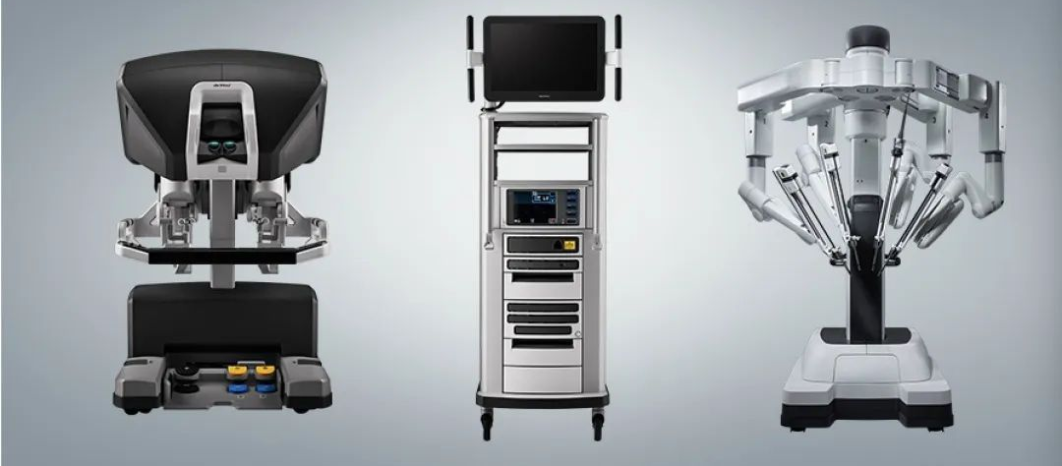
Modularity in Action: Da Vinci Robot System
Case Study:
  The 5th Generation Da Vinci Surgical Robot System
Enabling Feature:
  Highly modular architecture, particularly its detachable and independently functional Surgical Arms
Proposed Model:
  Full system purchase → flexible component rental model
  Institutions can rent the specific component needed for scheduled procedures, rather than investing in a complete, potentially underused, system.

Slide 6
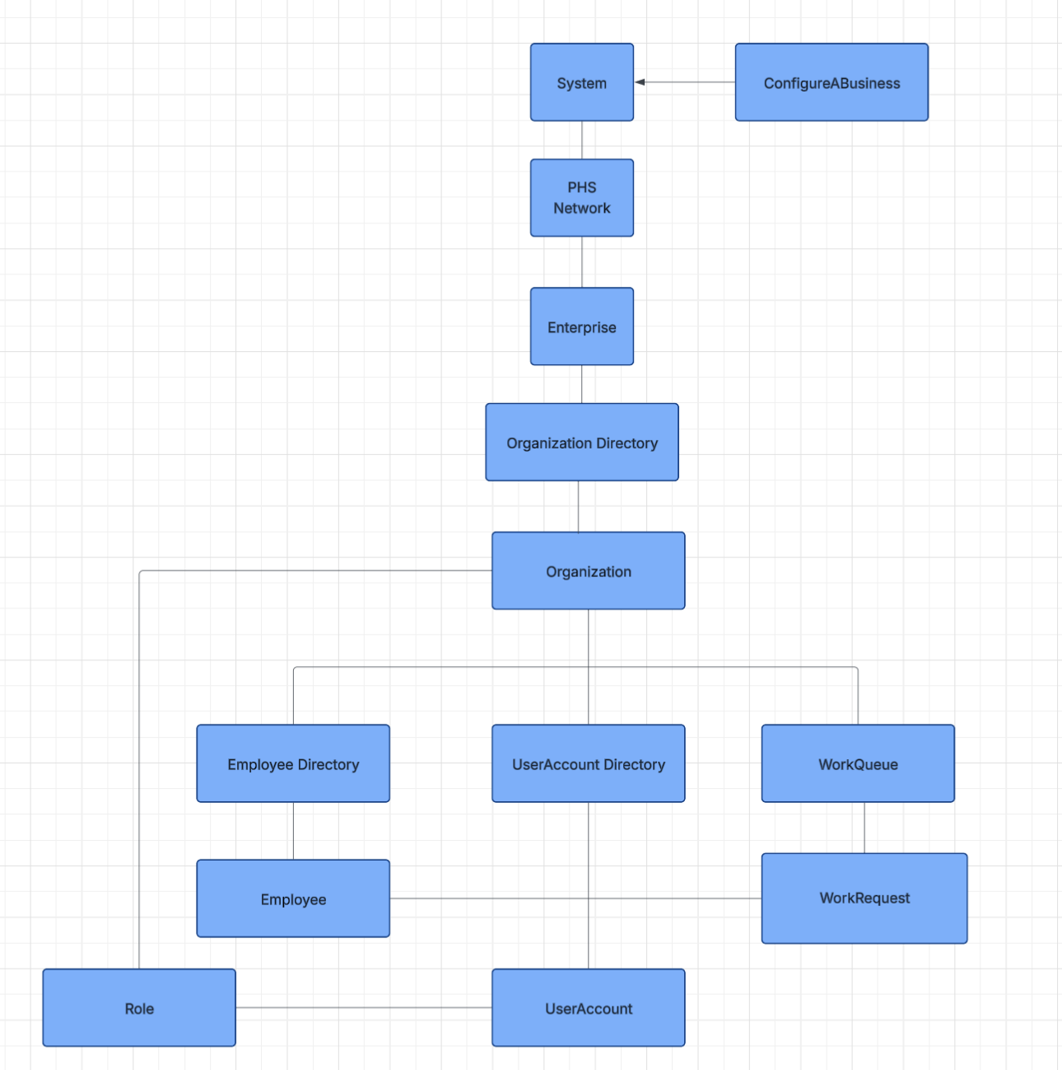
Object Model for Work Request

Slide 7
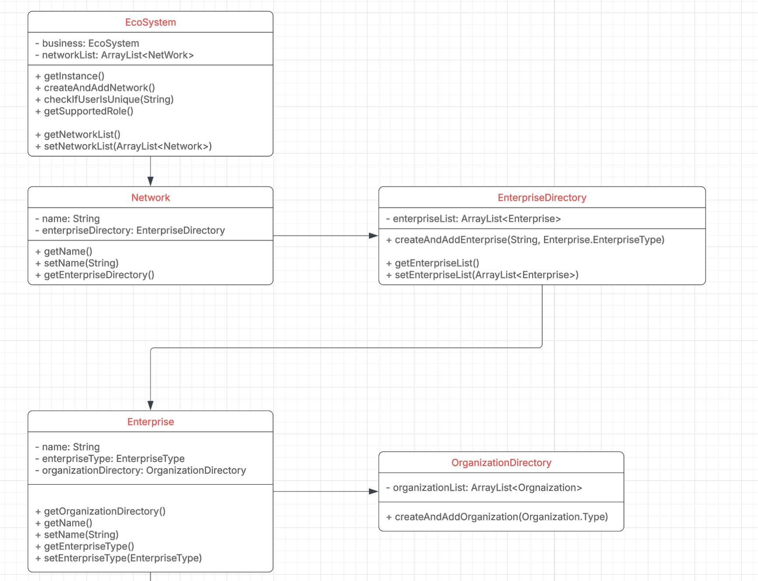
Diagram

Slide 8
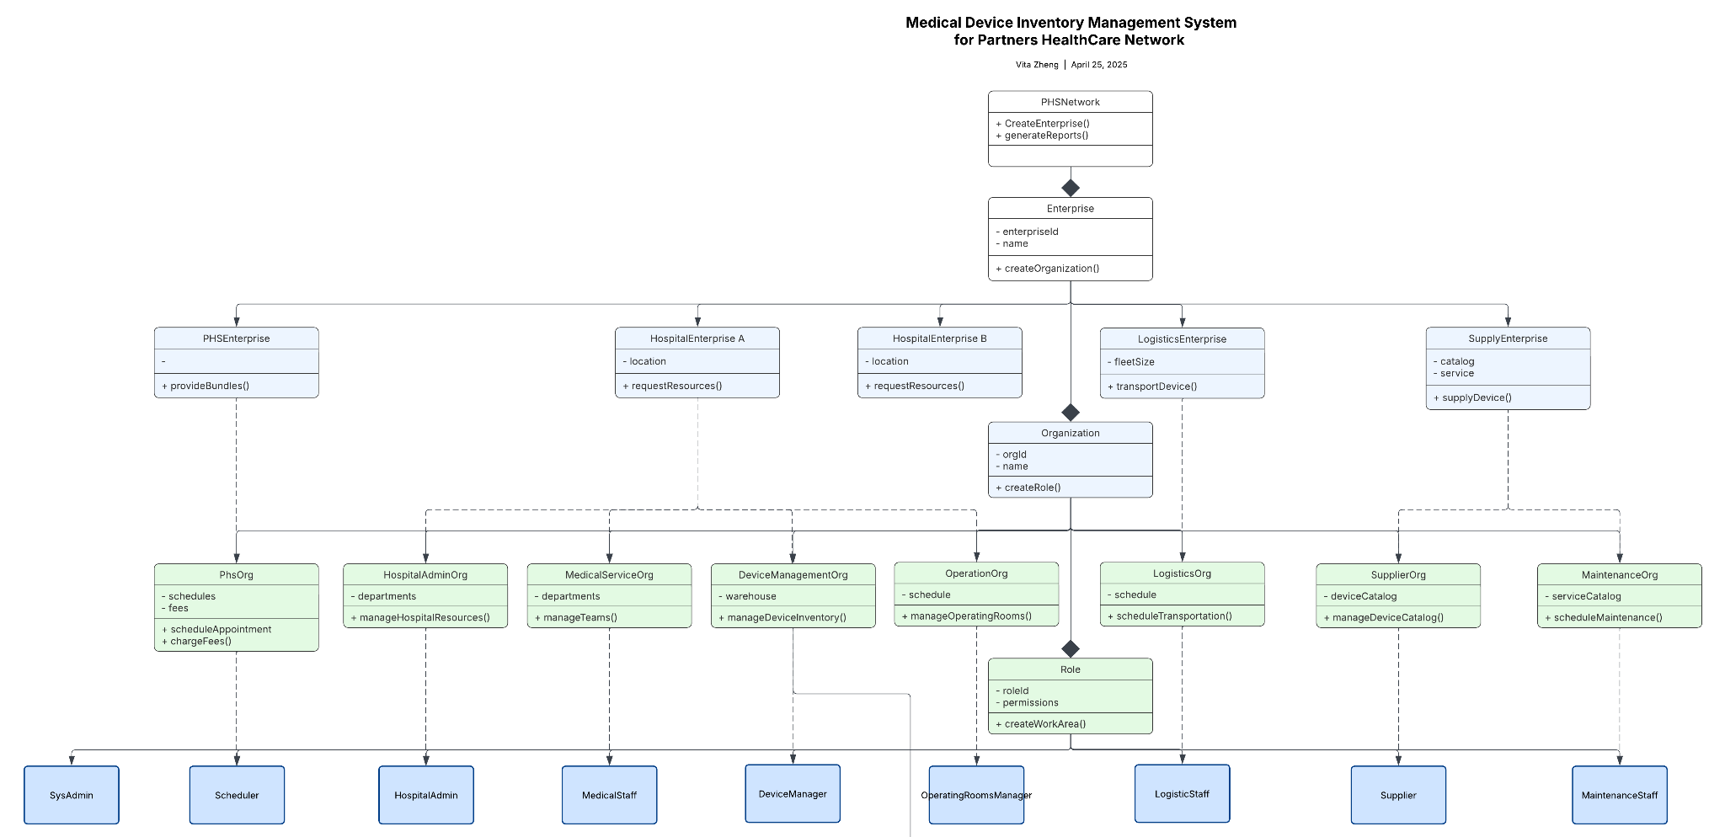
Diagram

Slide 9
Project Structure of PHS Network
Network
PHS Network
Enterprise
PHS Enterprise
Hospital 1
Hospital 2
Supply
Logistics
Organization
PHS Organization
Admin
System Admin
Device Management
Supplier
Maintenance
Operations Management
Doctor
Operations Management
Roles
Medical Team
Admin
Medical Team
Doctor
Device Manager
Supplier
Logistics Manager
System Admin
Operating Room Manager
Scheduler

Slide 10
Device Acquisition Logic
Functionality: The application can be able to place devices request, and then supplier organization can approval and reject this request based on their device inventory.
Doctor: (based on medical demands to reserve a device with certain date and duration.
Device Manager: (check if the device is available, if not or even if yes, they can still buy the device from suppliers based on their own preference).
Supplier: (approve device acquaization request and send the transfer request to Logistics).
Logistic Manager: (transfer the device to Device Manager)
Device Manager: confirm they have received the device;
Doctor: see the update of acquisition ID and device ID(which means Device is already in place for use)
Performance: The application should handle all the requests for device management and connect different requests into the closed loop.

Slide 11
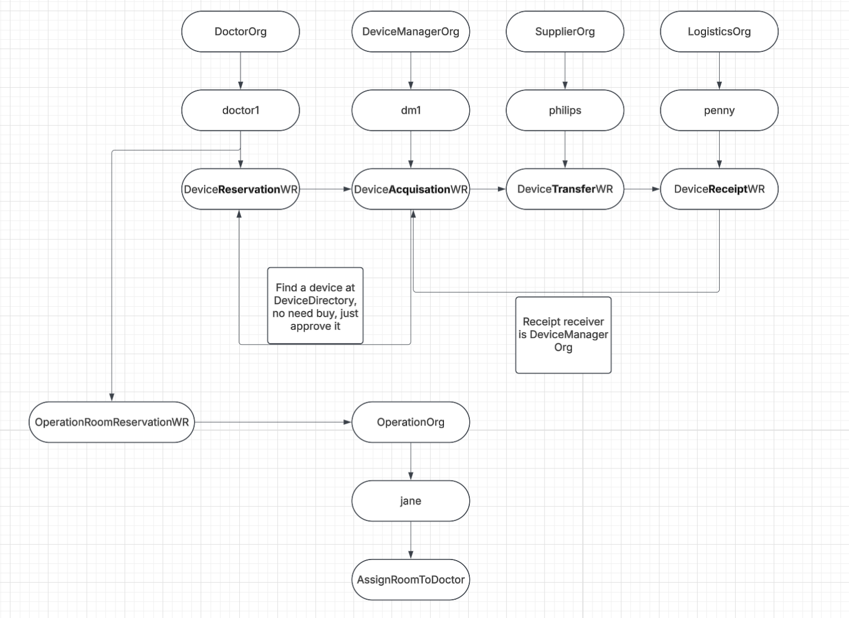
Device Procurement Workflow in one Hospital

Slide 12
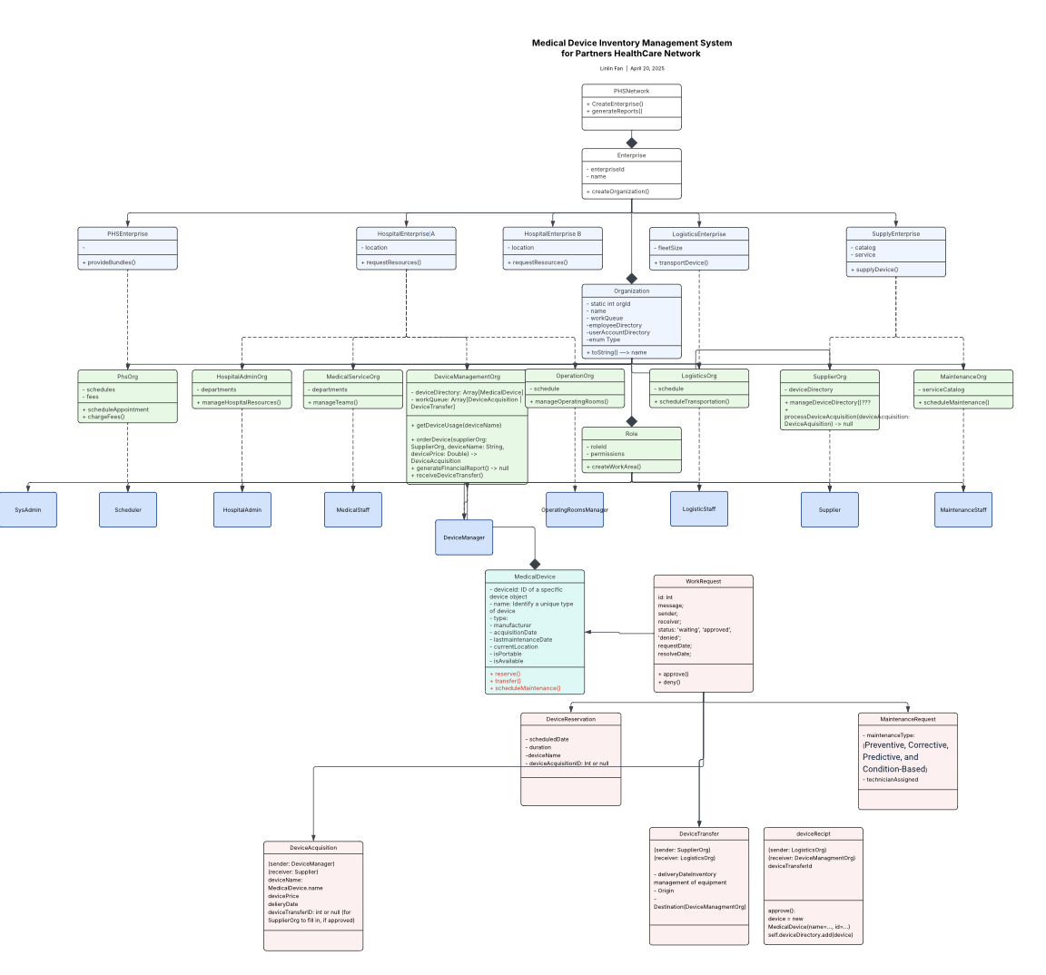
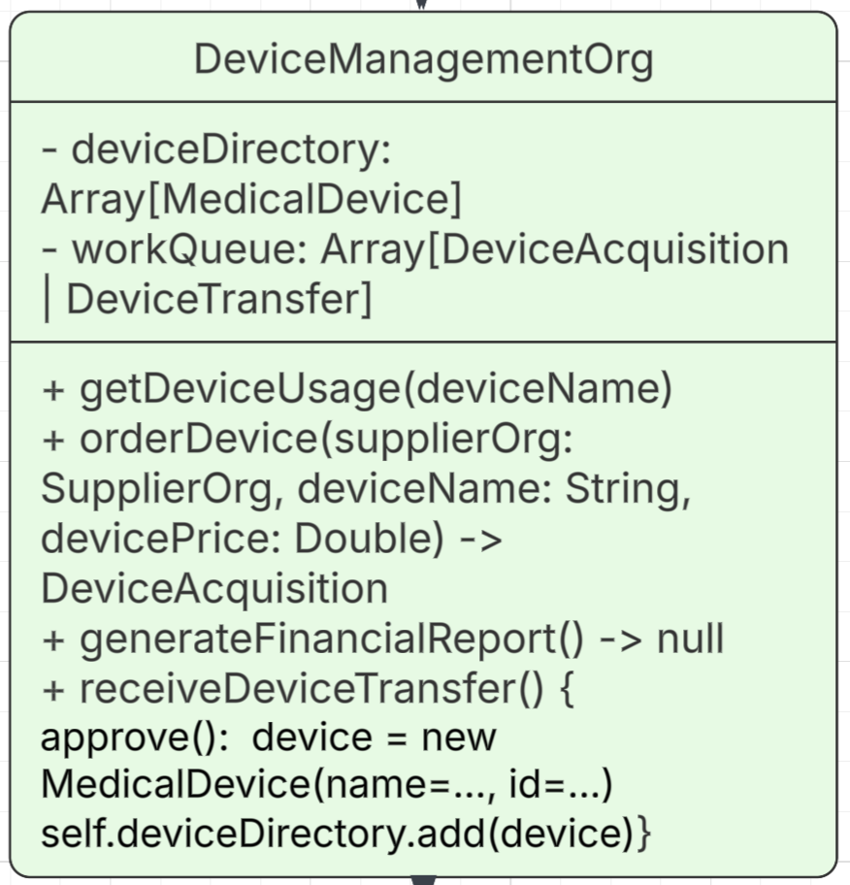
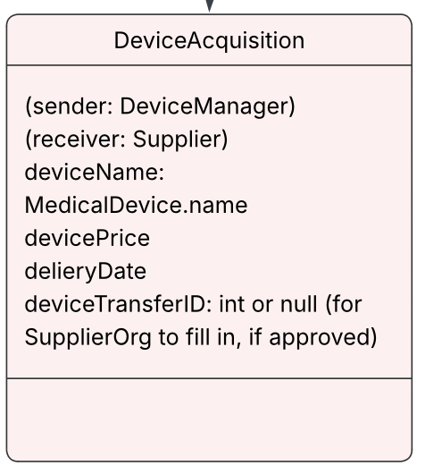
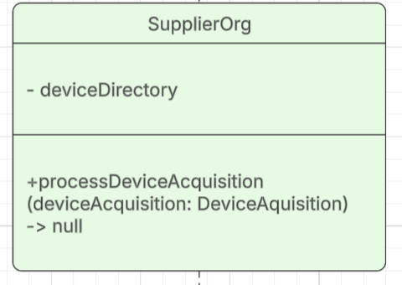
Diagram

Slide 13
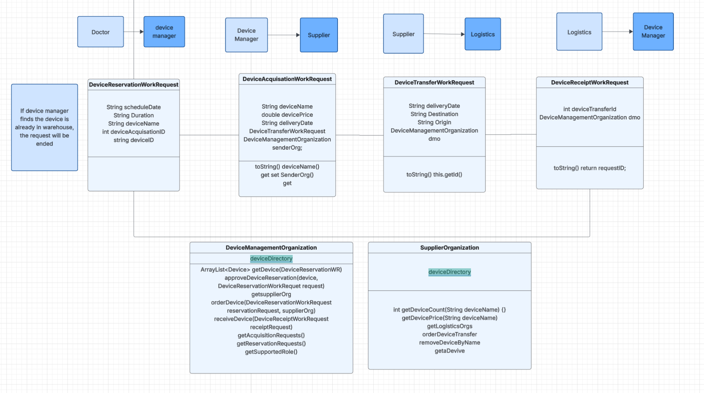

Slide 14
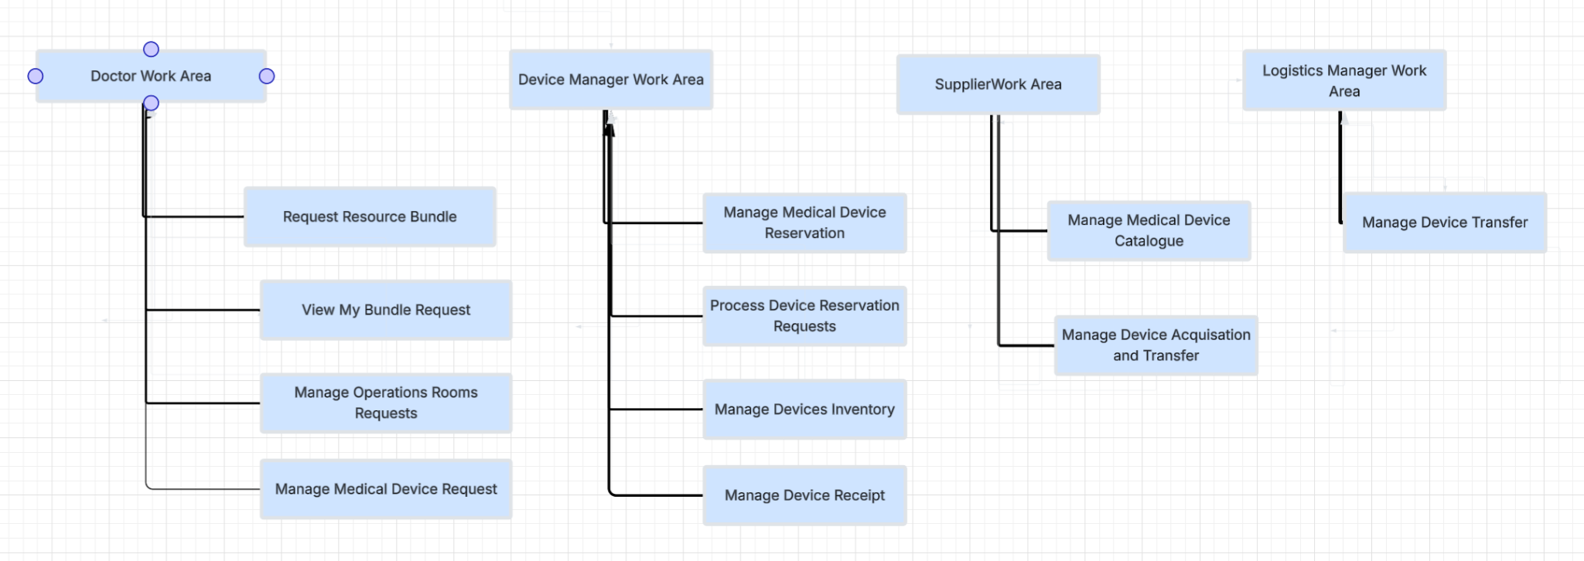

Slide 15
Resource Bundle Reservation Workflow
DoctorRole(RequestResourceBundle)
→ PHSAdmin(CreateResourceBundle)
→ Managers(ProcessReservationRequests)
→ PHSAdmin(ViewResourceBundles)
→ LogisticsManager(ManageDeviceTransfer)

Slide 16
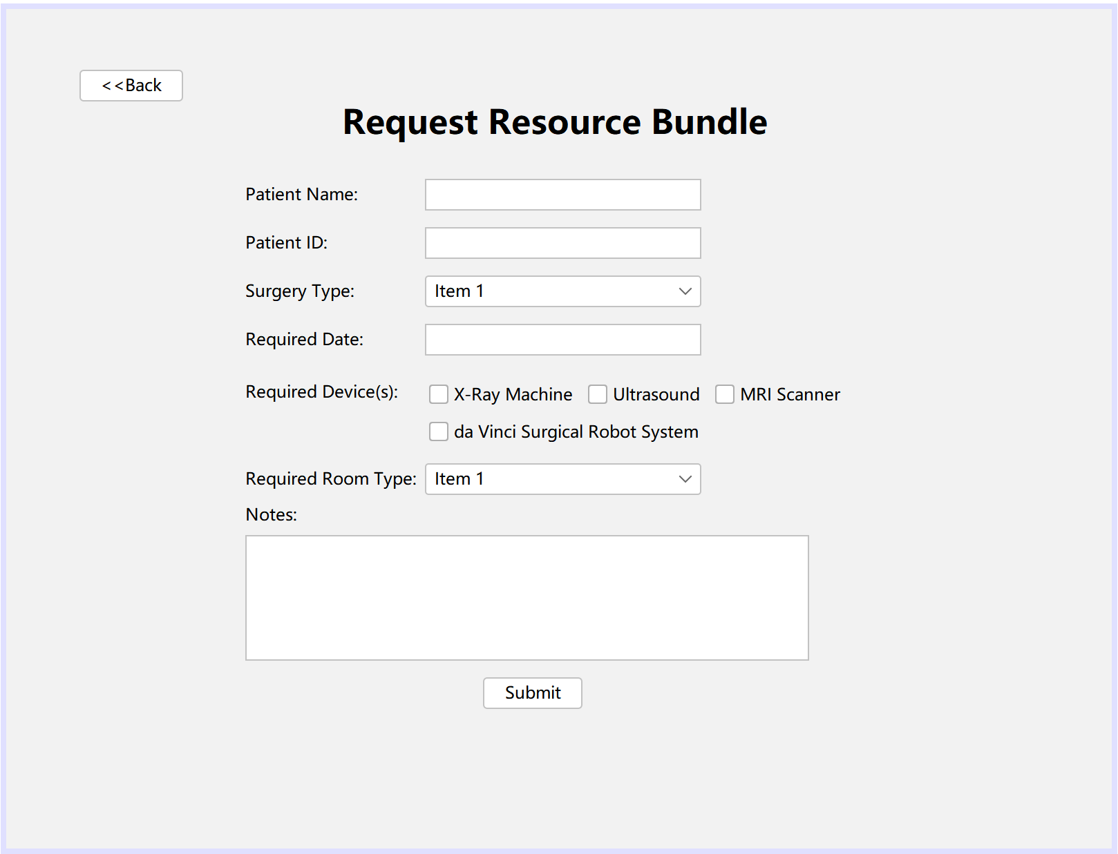
Resource Bundle Reservation Workflow - DoctorRole
private void setupDeviceRoomMapping() {
deviceRoomTypeMap.put("da Vinci Surgical Robot System", "Robotic OR");
deviceRoomTypeMap.put("X-Ray Machine", "Imaging Room");
deviceRoomTypeMap.put("MRI Scanner", "Imaging Room");
deviceRoomTypeMap.put("Ultrasound", "General OR");
}

Slide 17
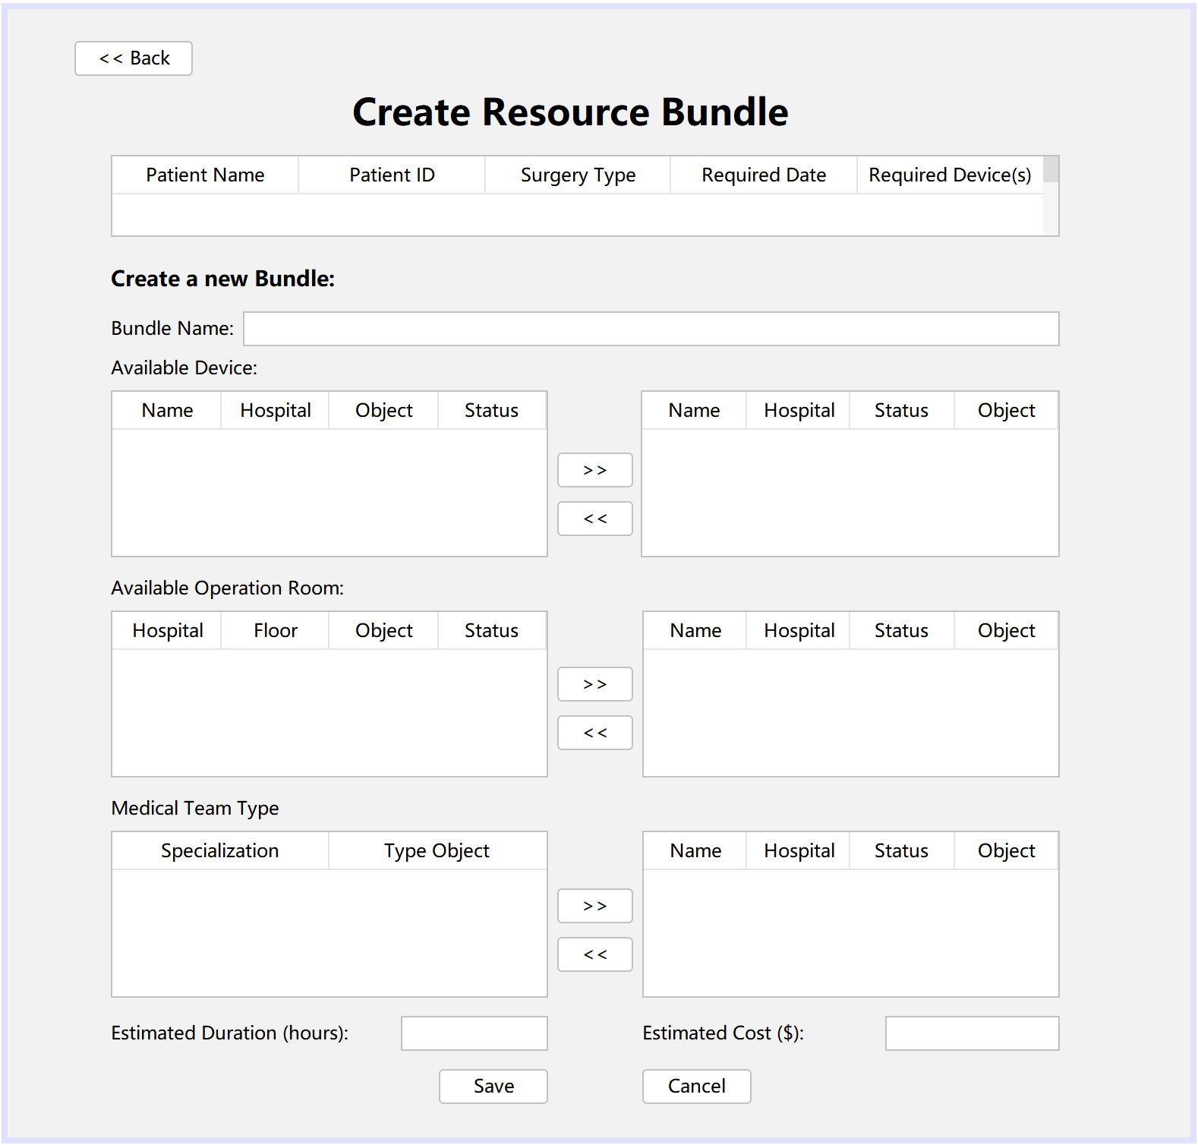
Resource Bundle Reservation Workflow - PHS
private boolean sendApprovalRequests();
private int sendDeviceRequests();
private boolean sendRoomRequest();
private int sendTeamRequests();
private int sendTransferRequests();
private void calculateTotalCost();

Slide 18
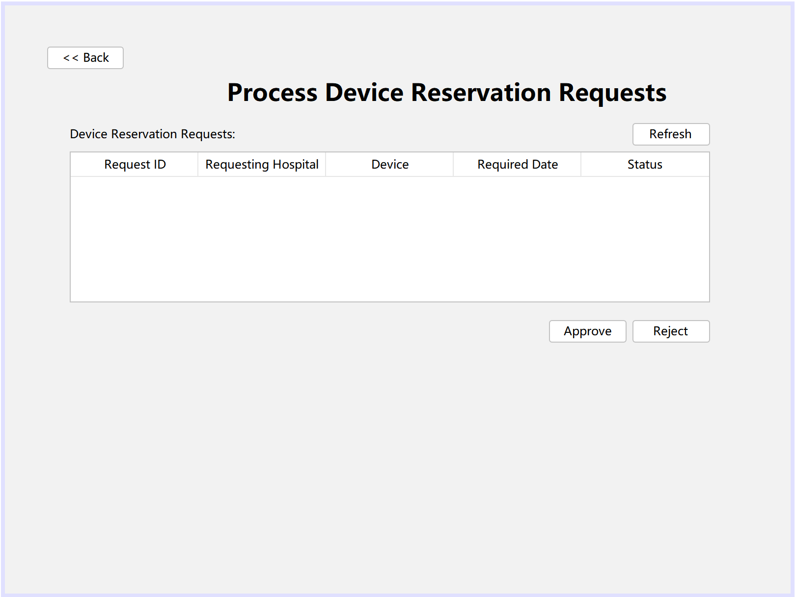
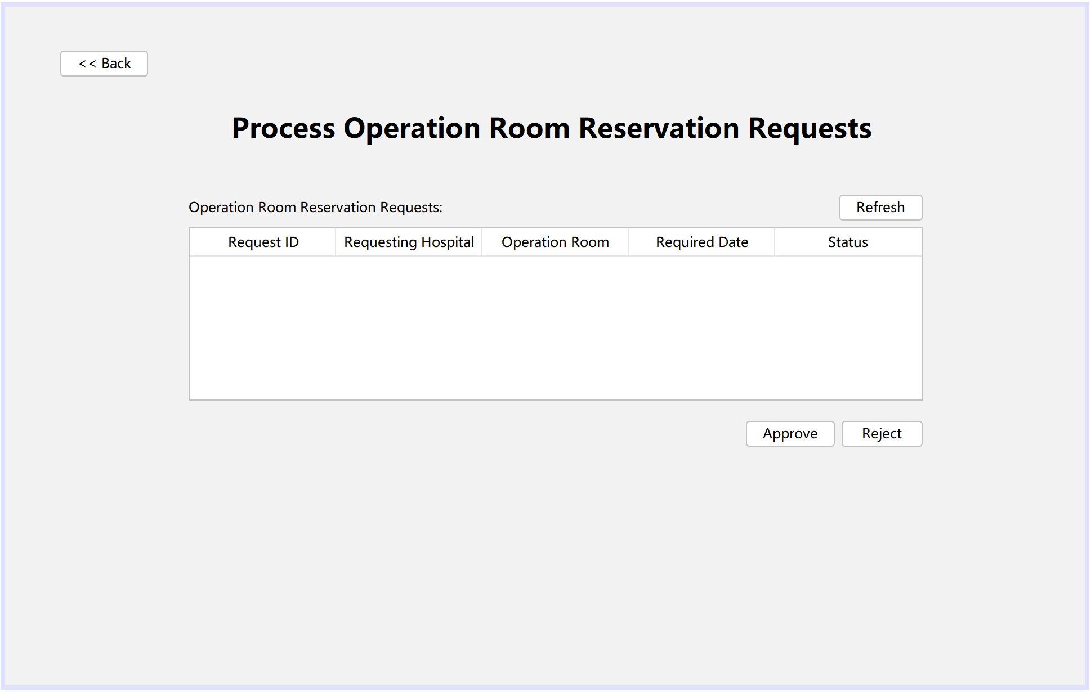
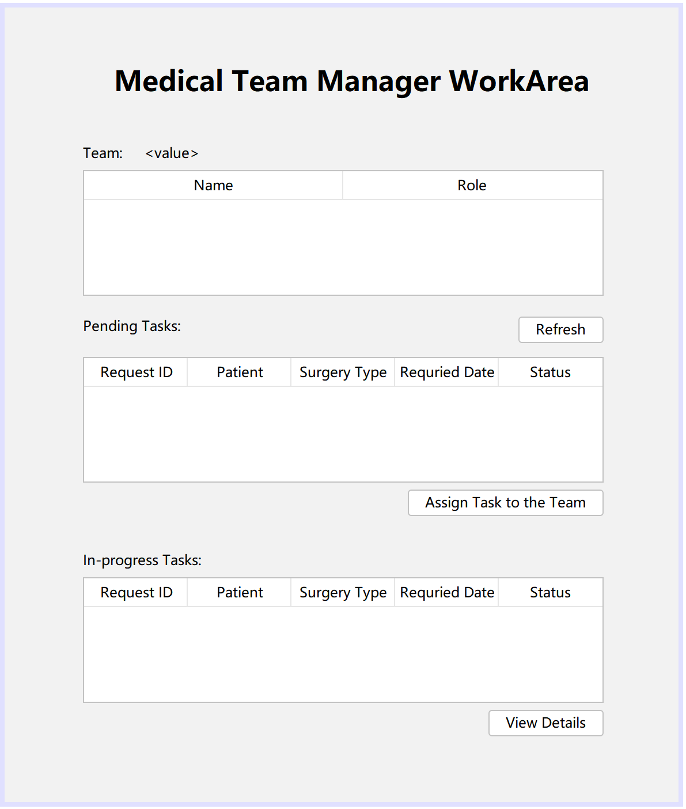
Resource Bundle Reservation Workflow - Manager

Slide 19
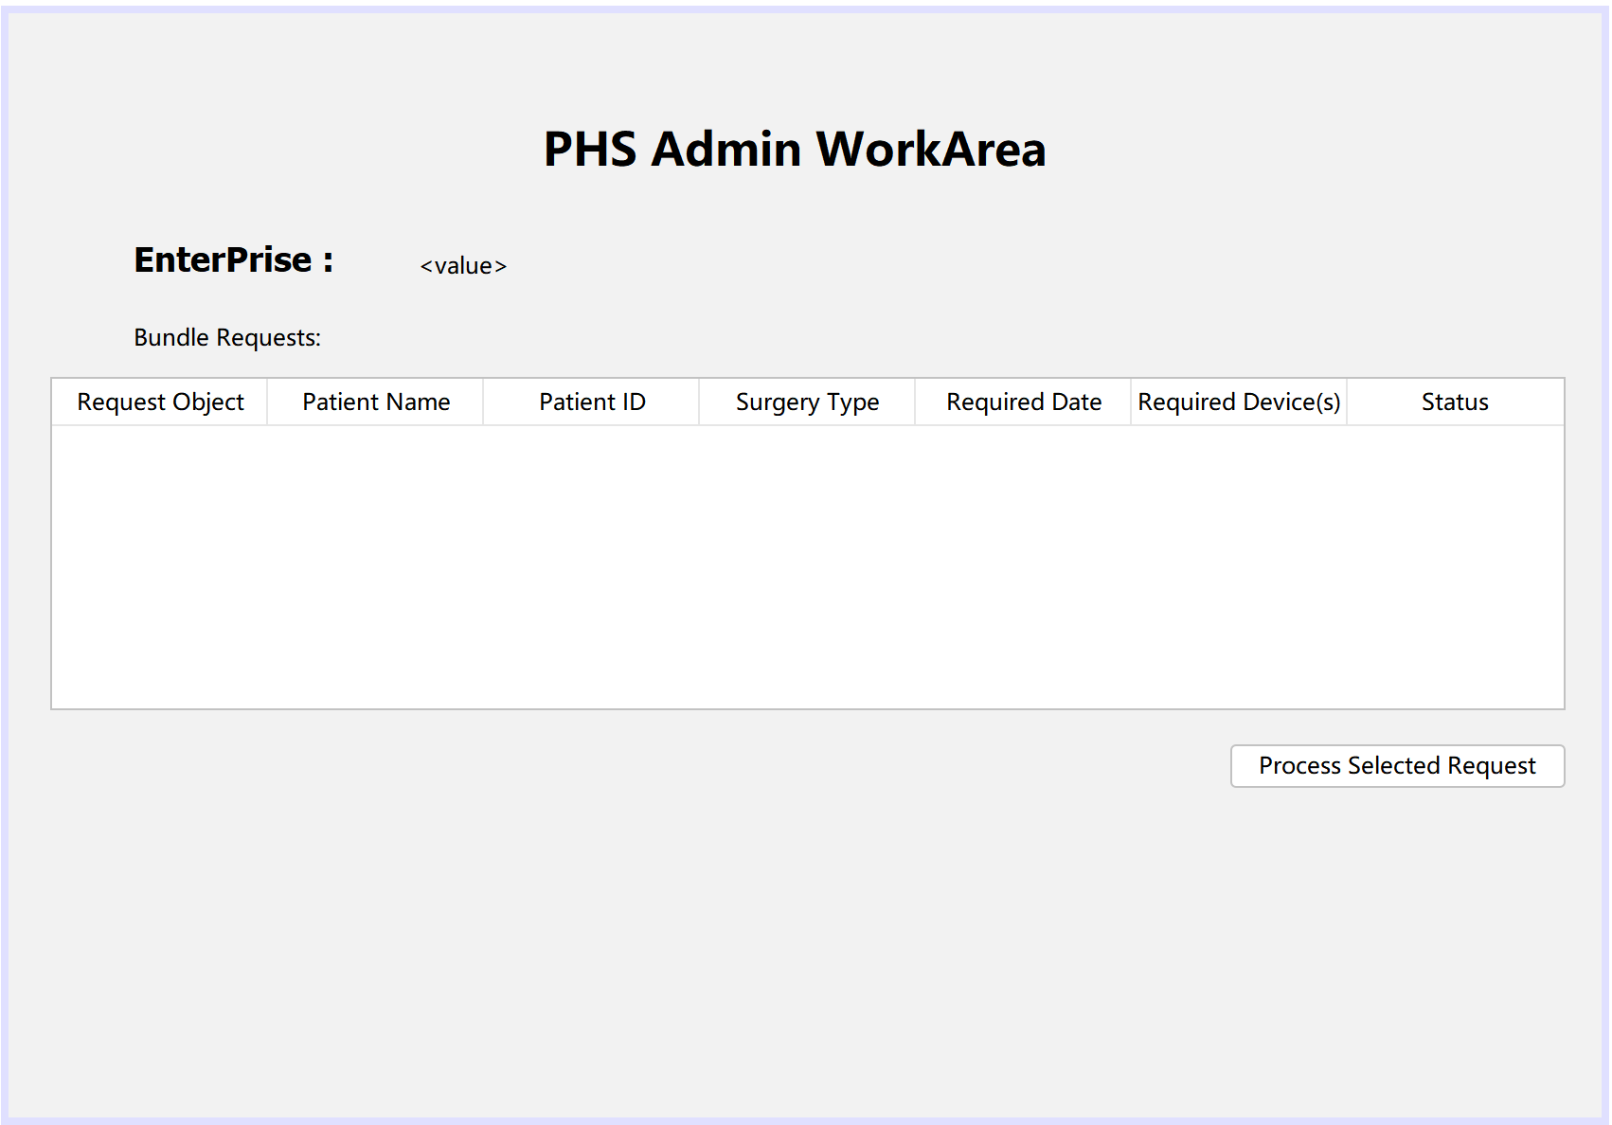
Resource Bundle Reservation Workflow: Completed

Slide 20
Device Maintenance
The maintainers, who are part of the Maintenance Organization, are responsible for maintaining the medical devices.
Devices are categorized using four color codes based on maintenance severity:
Yellow: Device has not been maintained for over 2 months.
Orange: Device has not been maintained for over 4 months.
Red: Device has not been maintained for over 6 months.
Once the maintenance is completed, the maintainer must update the maintenance status of the device to indicate it is complete.

Slide 21
Goals of the Project
Basic Goal: meet doctor’s device request. Implement different role to manage different part of this device directory.
Perfect Goal: To build a comprehensive, scalable, and secure Medical Device Inventory Management System that seamlessly meets the demands of healthcare professionals and administrators while ensuring that devices are managed efficiently, securely, and in compliance with all relevant regulations.

Slide 22
Q&A

Slide 23
Thank you

